Slide 1
Ze Scrapbook o’ History n’ stuff
Nick Tureaud and Brendon Code

Slide 2
Early Civilizations
Hieroglyphics
The great pyramid
Early Buddhist sculptures
Chines potters create leak proof stoneware
Plague kills 1/3 of Athens

Slide 3
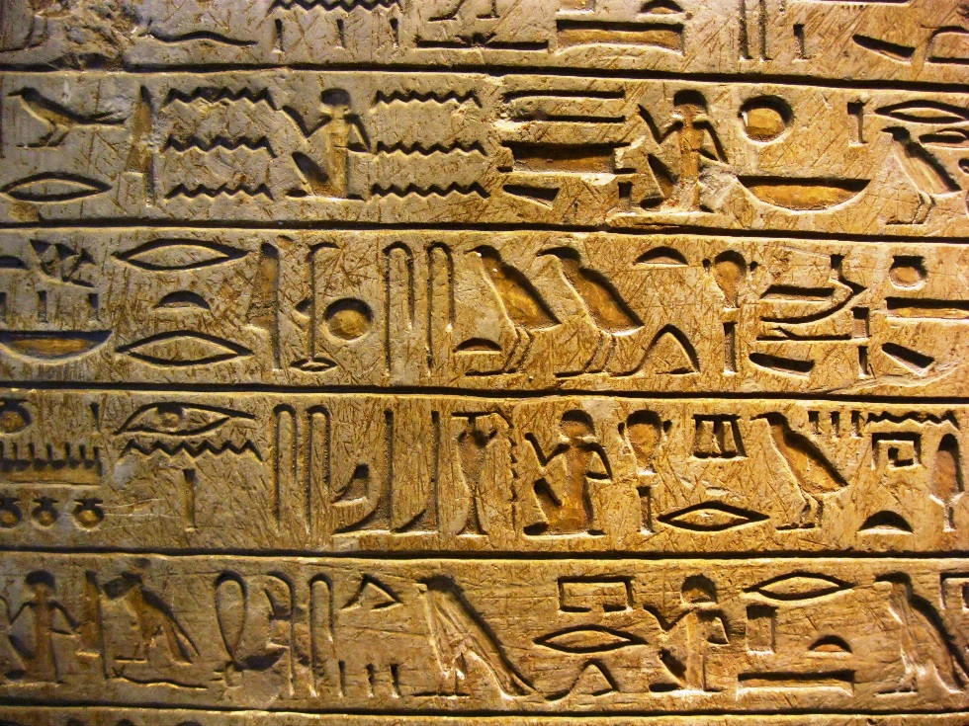
Hieroglyphics
Egyptian hieroglyphs were a formal writing system used by the ancient Egyptians. Hieroglyphs were pictographic symbols with meaning of objects or actions.

Slide 4
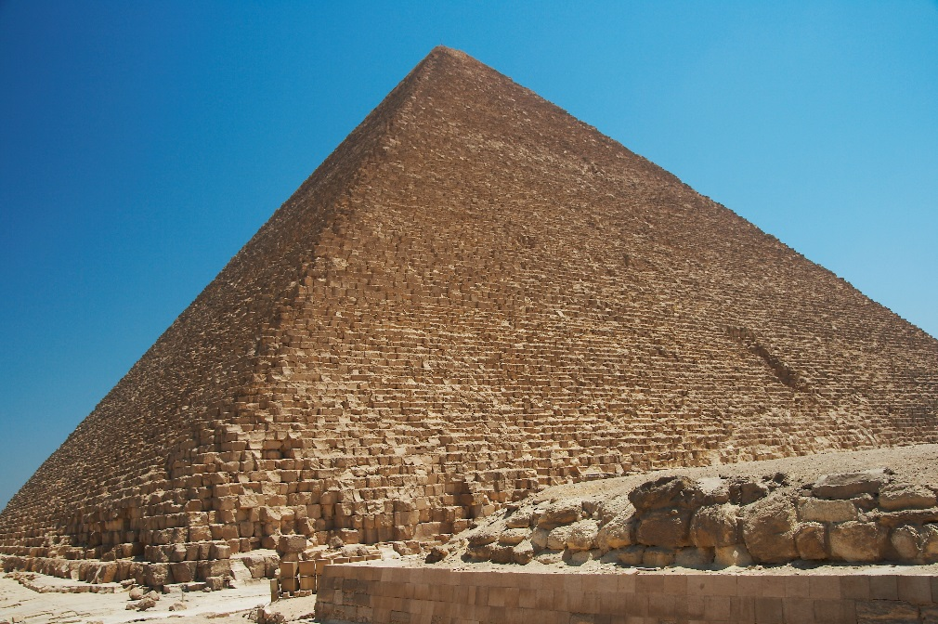
The great pyramid of Giza
The Great Pyramid of Giza is the oldest and largest of the three pyramids in the Giza Necropolis. It is the oldest of the Seven Wonders of the Ancient World and it is the only one still mostly intact.

Slide 5
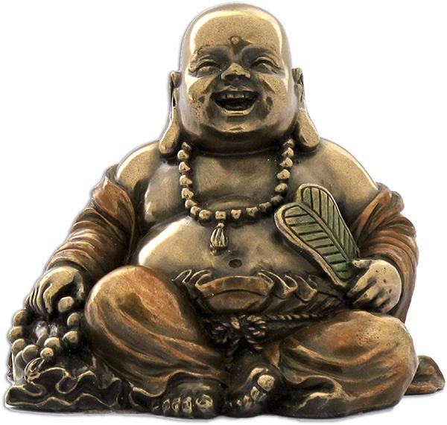
Buddhists Sculptures
Buddhist sculptures show stories of the great Buddha. Sculptures are used to teach lessons.

Slide 6
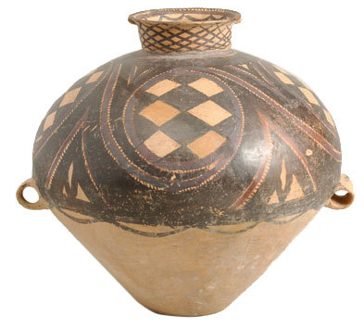
Chinese creates leak-proof pottery
The Chines first created leak proof pottery by using decorative glazes. Before the glaze, liquid could seep through the pores of pots, which makes them insufficient for long term storage.

Slide 7
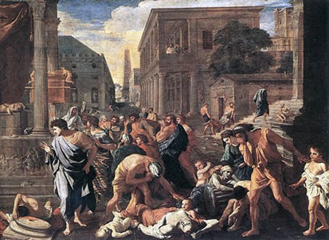
Plague kills 1/3rd of Athens population
The Plague of Athens killed 1/3rd of Athens, causing them to lose the Peloponnesian War.

Slide 8
Classical Civilizations
Julius Caesar is assassinated
Chinese first gun-powder in warfare

Slide 9
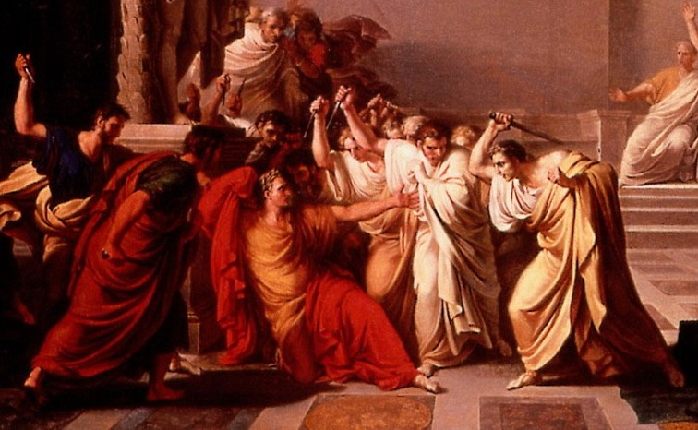
Julius Caesar is assassinated
The assassination of Julius Caesar was the result of a conspiracy by many Roman senators who were called Liberators, led by Gaius Cassius Longinus and Marcus Junius Brutus. They stabbed Caesar to death in the Theatre of Pompey on the Ides of March. Caesar was declared dictator perpetuo by the Senate, which made several senators fear that Caesar wanted to overthrow the Senate in favor of tyranny.

Slide 10
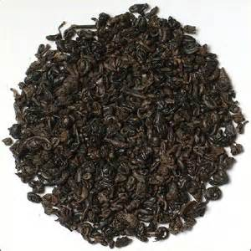
Chinese first gun-powder in warfare
small packages of gunpowder wrapped in paper or bamboo were attached to arrows. These would be lit with a fuse of some kind, so that the arrow became an incendiary, intended to set targets afire.

Slide 11
Middle ages
Genghis Khan becomes chief prince of the Mongols
Public hospital in Baghdad
Vandals attack rome
Black death sweeps through Europe

Slide 12
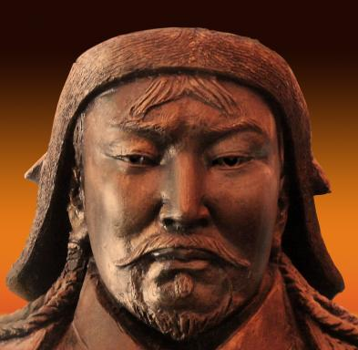
Genghis Khan becomes prince of the Mongols
Developed into an honorable and ferocious warrior.

Slide 13
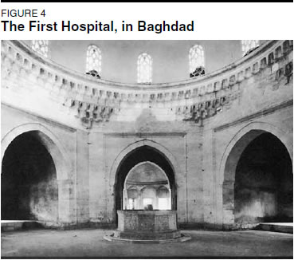
Public hospital in Baghdad
One of the greatest achievements in Islamic Society. In Islam there was generally a moral imperative to treat all the ill, they were open to all, male and female, civilian and military, adult and child, rich and poor, Muslims and non-Muslims. They tended to be large, urban structures.

Slide 14
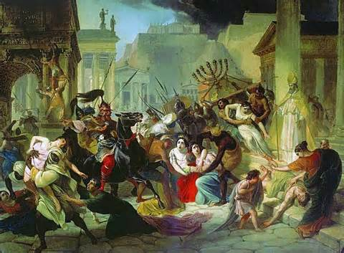
Vandals attack Rome
The sack of 455 was the second of three sacks of Rome. This was performed by Vandals, who were then at war with the Western Roman Emperor.

Slide 15
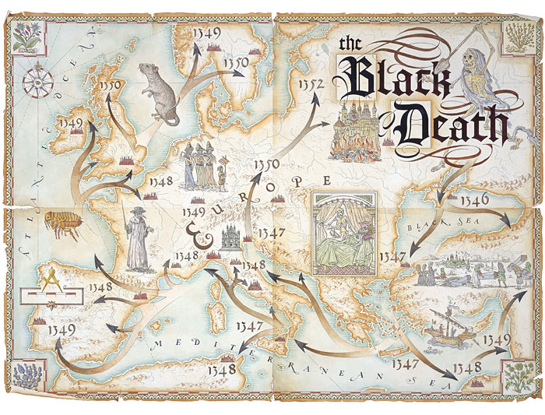
Black death sweeps through Europe
The Black Death was a terrible plague, and resulted in the deaths of 75 to 200 million people. It was estimated to have killed 30–60% of Europe's total population.

Slide 16
Global interaction
Chocolate used as currency in Maya
Leonardi da vinci designs a hot air turbine engine to turn a spit
William Shakespeare publishes a book of sonnets
The Chinese build the great Temple of the Dragon in Peking

Slide 17
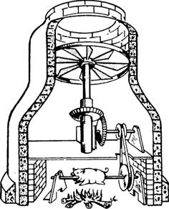
Leonardo da Vinci designs a hot air turbine engine to turn a spit
Leonardo da Vinci designed a hot air turbine in the chimney of a fire place that turned a spit over the fire. It influenced every turbine design since then.

Slide 18
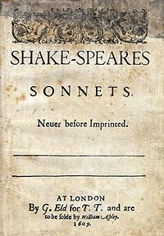
William Shakespeare publishes book of sonnets
Shakespeare's sonnets are a collection of 154 sonnets, dealing with themes such as the passage of time, love, beauty and mortality, first published in a 1609 quarto entitled SHAKE-SPEARES SONNETS. Never before imprinted.

Slide 19
The Chinese build the great Temple of the Dragon in Peking
Also know as the temple of heaven, The Great Temple of the Dragon is a complex religious building near Southeastern Beijing made in 1406.

Slide 20
Revolutions
Russia declares war on Ottoman empire
The U.S. declares independence from Great Britain
England prohibits the slave trade
Great Britain and Ireland form United Kingdom
Alexander Bell patents telephone
President Lincoln issues the Emancipation Proclamation

Slide 21
Russia declares war on Ottoman Empire
On 31 July 1914, Tsar Nicholas II ordered the full mobilization of the Russian Army in response to Germany’s obvious preparations for war in the east. Enver Pasha, the Ottoman Minister for War, reacted by ordering the full mobilization of the Ottoman Army. On 2 August he signed a secret treaty with the German Ambassador.

Slide 22
U.S. declares independence from Great Britain
On July 4th, 1776, in Philadelphia, Pennsylvania, the Continental Congress adopts the Declaration of Independence, which proclaims the independence of a new United States of America from Great Britain and its king.

Slide 23
England prohibits the slave trade
On 25 March 1807, an act with the title of "An Act for the Abolition of the Slave Trade" was passed. The act abolished the slave trade in the British Empire, and also encouraged the people to press other European nations to abolish their slaves trades, but it failed to abolish slavery itself.

Slide 24
Great Britain and Ireland form United Kingdom
The Union of Crowns in 1603, the accidental consequence of a royal marriage one hundred years earlier, united the kingdoms in a personal union. A further Act of Union in 1800 included Ireland in the Union to form the United Kingdom of Great Britain and Ireland.

Slide 25
Alexander Bell patents telephone
United States Patent No. 174,465 was given to Alexander Graham Bell in 1876. It became the most valuable patent in history.

Slide 26
President Lincoln issues Emancipation Proclamation
The Emancipation Proclamation issued by President Abraham Lincoln on January 1, 1863. It freed slaves in the ten states that were still in rebellion, thus applying to 3 million of the 4 million slaves in the U.S. at the time.

Slide 27
Modern World
Modern machine gun invented
Germany informs the allies that it cannot make war reparations payments on schedule
The US invades Grenada

Slide 28
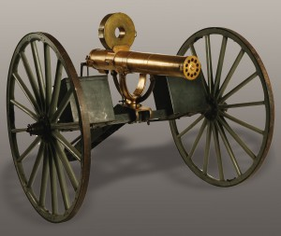
Modern machine gun invented
The first machine gun was the Model 1862 Gatling gun, which was adopted by the U.S. Navy.

Slide 29
Germany informs that it can’t pay reparations
Germany stopped paying the reparations after Hitler's Nazi Party took power in 1933. About one-eighth of the reparations paid by then. The final payments were made on the day exactly 20 years after German reunification.

Slide 30
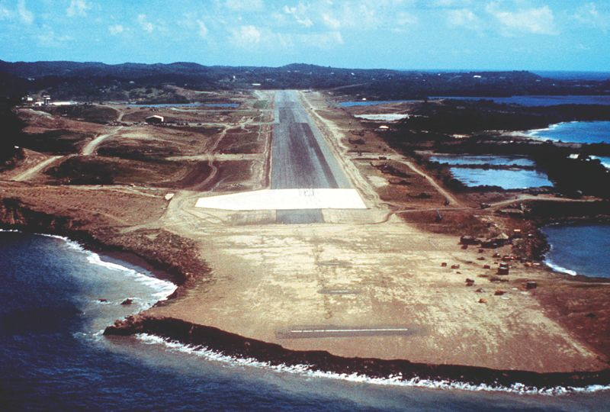
The US invades Grenada
Known as operation Urgent Fury in 1983, the United States invaded Grenada to stop them from helping the Russians build their air fleet by providing an excessively large airport.

